Slide 1
DC Circuits
Delta and wye connections
By Dr. Ahmed S. Abdullah
د. احمد سليمان عبدالله

Slide 2
Y- $∆$ (T- $π$) AND $∆$ -Y ($π$ -T) CONVERSIONS
Circuit configurations are often encountered in which the resistors do not appear to be in series or parallel.
Under these conditions, it may be necessary to convert the circuit from one form to another to solve for any unknown quantities if mesh or nodal analysis is not applied.
Two circuit configurations that often account for these difficulties are the wye (Y) and delta ($∆$) configurations, depicted in Fig. 8.72(a).
They are also referred to as the tee (T) and pi ($π$), respectively, as indicated in Figure. Note that the pi is actually an inverted delta.

Slide 3
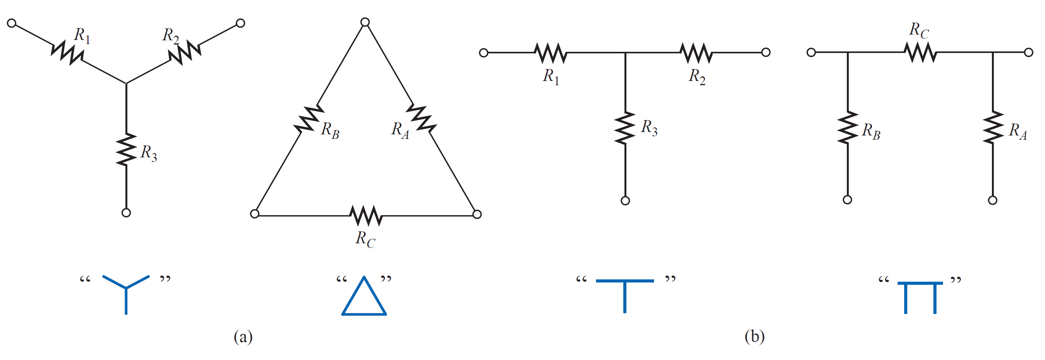
Y- $∆$ (T- $π$) AND $∆$ -Y ($π$ -T) CONVERSIONS

Slide 4
Y- $∆$ (T- $π$) AND $∆$ -Y ($π$ -T) CONVERSIONS

Slide 5
Y- $∆$ (T- $π$) AND $∆$ -Y ($π$ -T) CONVERSIONS

Slide 6
Y- $∆$ (T- $π$) AND $∆$ -Y ($π$ -T) CONVERSIONS

Slide 7
Y- $∆$ (T- $π$) AND $∆$ -Y ($π$ -T) CONVERSIONS

Slide 8
Delta to Wye Conversion

Slide 9
Delta to Wye Conversion

Slide 10
Delta to Wye Conversion

Slide 11
Delta to Wye Conversion

Slide 12
Delta to Wye Conversion

Slide 13
Delta to Wye Conversion

Slide 14
Delta to Wye Conversion

Slide 15
Delta to Wye Conversion

Slide 16
Delta to Wye Conversion

Slide 17
Delta to Wye Conversion

Slide 18
Delta to Wye Conversion

Slide 19
Delta to Wye Conversion

Slide 20
Delta to Wye Conversion

Slide 21
Delta to Wye Conversion
Subtracting Eq. (3) from Eq. (1) and adding the resulting equation to Eq. (1) results in :-

Slide 22
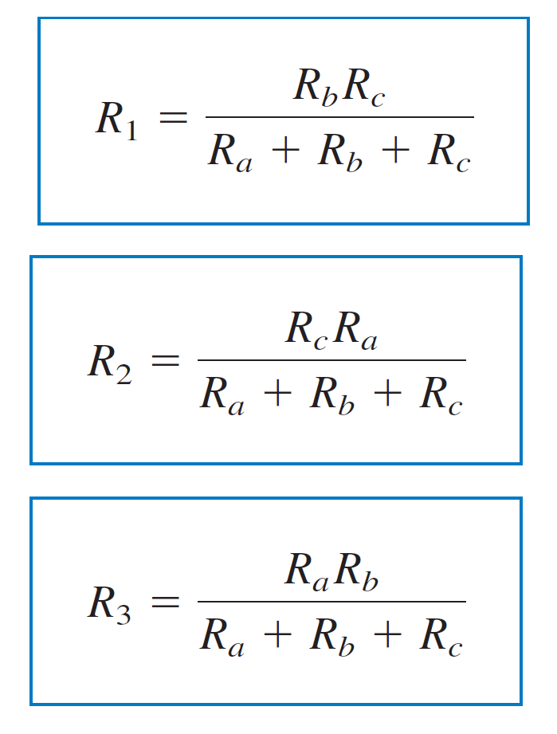
Delta to Wye Conversion
Similarly,
and,

Slide 23
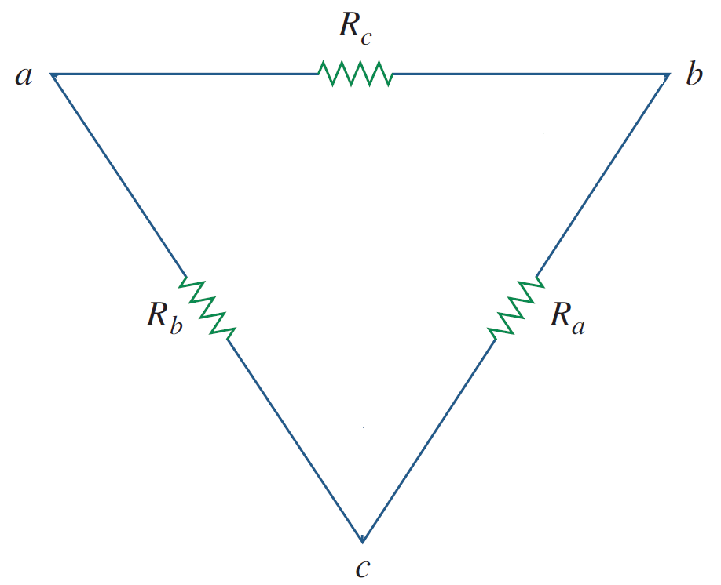
Delta to Wye Conversion
Similarly,
and,

Slide 24
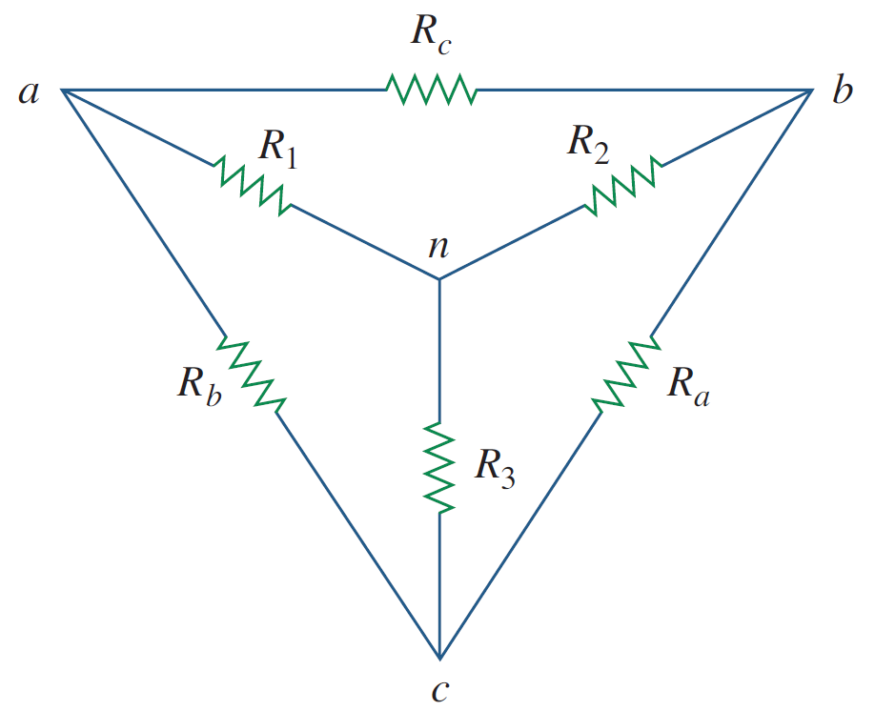
Delta to Wye Conversion
Similarly,
and,

Slide 25
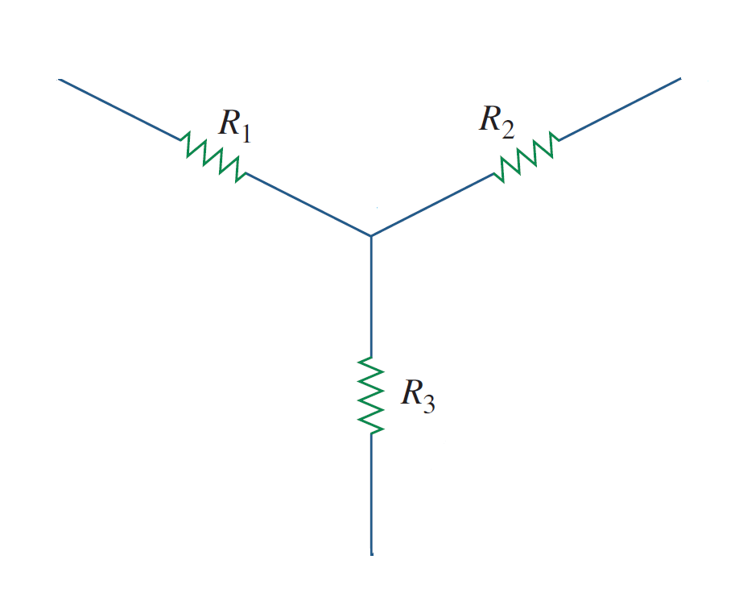
Delta to Wye Conversion
Similarly,
and,

Slide 26
Wye to Delta Conversion

Slide 27
Wye to Delta Conversion

Slide 28
Wye to Delta Conversion

Slide 29
Wye to Delta Conversion

Slide 30
Wye to Delta Conversion
Using the previous sets of equations, then

Slide 31
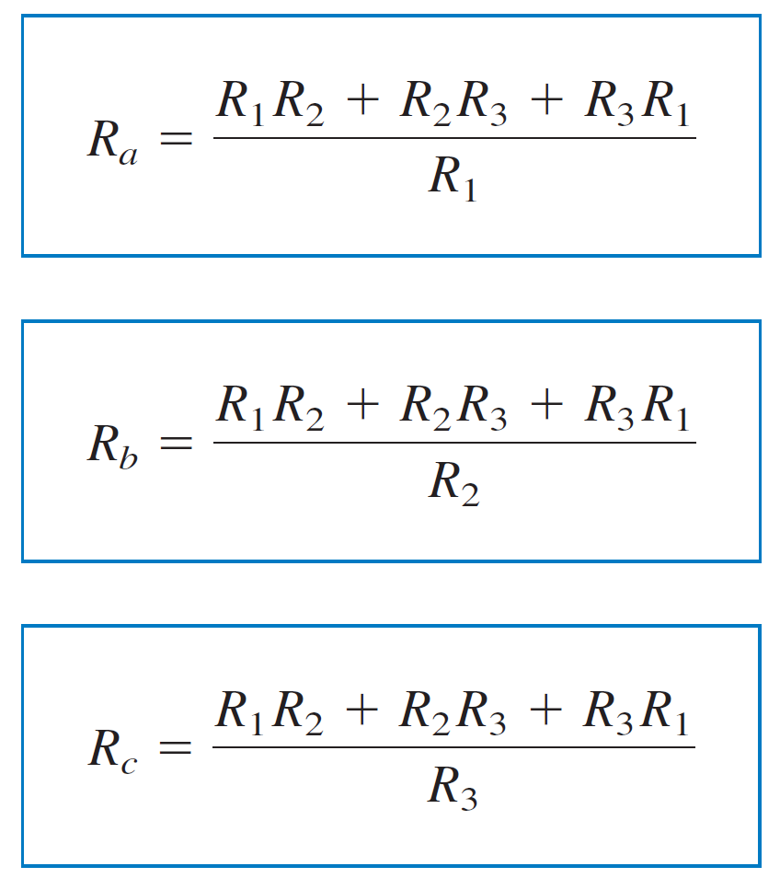
Wye to Delta Conversion
Using the previous sets of equations, then

Slide 32
Wye to Delta Conversion

Slide 33
Wye to Delta Conversion

Slide 34
Wye to Delta Conversion

Slide 35
Y- $∆$ AND $∆$ -Y CONVERSIONS
The Y and $∆$networks are said to be balanced when

Slide 36
Y- $∆$ AND $∆$ -Y CONVERSIONS
The Y and $∆$networks are said to be balanced when

Slide 37
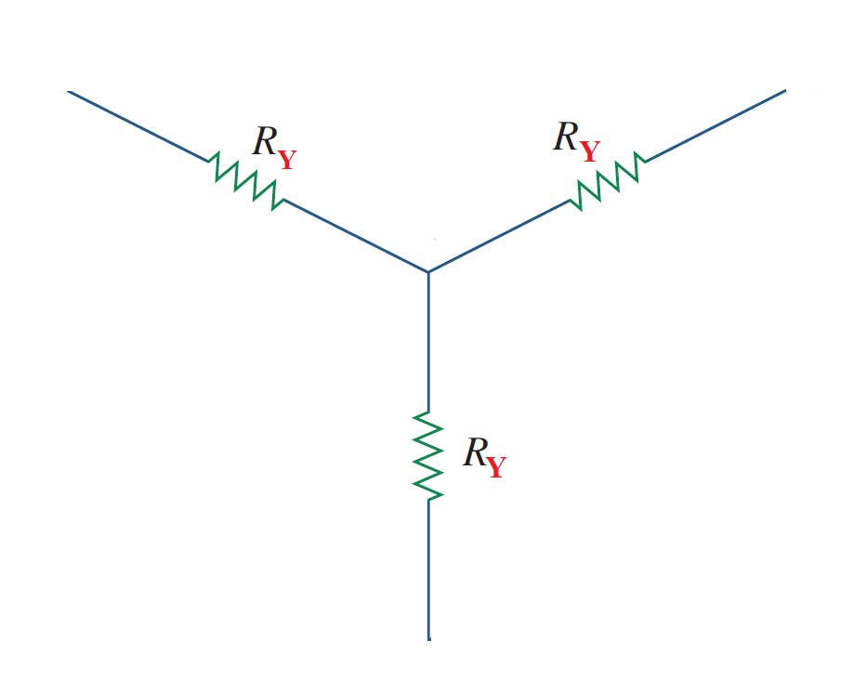
Y- $∆$ AND $∆$ -Y CONVERSIONS
The Y and $∆$networks are said to be balanced when

Slide 38
Y- $∆$ AND $∆$ -Y CONVERSIONS
The Y and $∆$networks are said to be balanced when

Slide 39
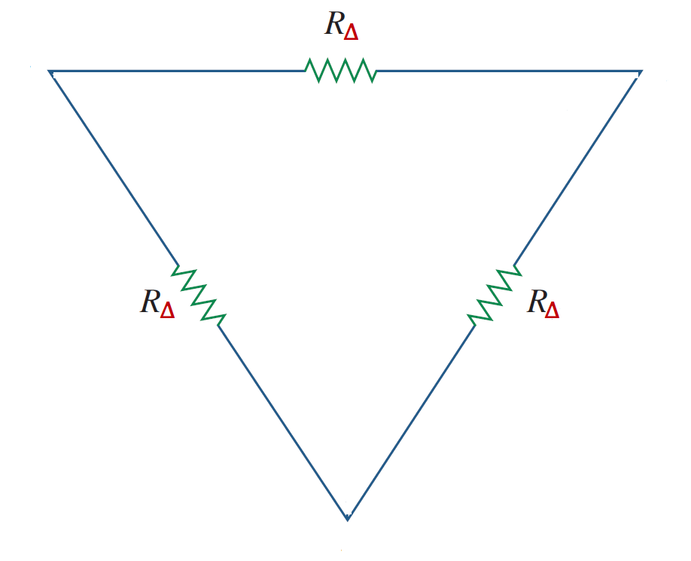
Y- $∆$ AND $∆$ -Y CONVERSIONS
The Y and $∆$networks are said to be balanced when

Slide 40
Y- $∆$ AND $∆$ -Y CONVERSIONS
The Y and $∆$networks are said to be balanced when
Under these conditions, conversion formulas become

Slide 41
Y- $∆$ AND $∆$ -Y CONVERSIONS
Example Convert the $∆$ network in Figure shown to an equivalent Y network.

Slide 42
Y- $∆$ AND $∆$ -Y CONVERSIONS
Example Convert the $∆$ network in Figure shown to an equivalent Y network.

Slide 43
Y- $∆$ AND $∆$ -Y CONVERSIONS
Example Convert the $∆$ network in Figure shown to an equivalent Y network.

Slide 44
Y- $∆$ AND $∆$ -Y CONVERSIONS
Example Convert the $∆$ network in Figure shown to an equivalent Y network.

Slide 45
Y- $∆$ AND $∆$ -Y CONVERSIONS
Example Convert the $∆$ network in Figure shown to an equivalent Y network.

Slide 46
Y- $∆$ AND $∆$ -Y CONVERSIONS
Example Convert the $∆$ network in Figure shown to an equivalent Y network.

Slide 47
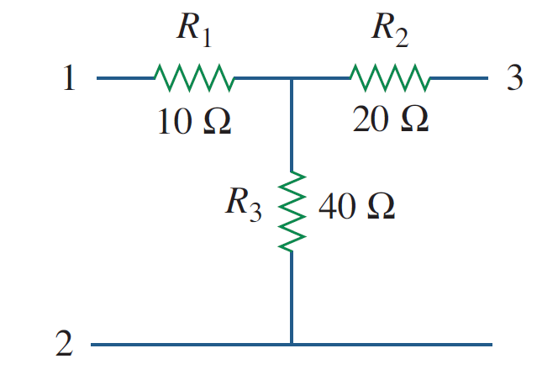
Y- $∆$ AND $∆$ -Y CONVERSIONS
Example Transform the wye network in Figure shown to a delta network.

Slide 48
Y- $∆$ AND $∆$ -Y CONVERSIONS
Example Transform the wye network in Figure shown to a delta network.

Slide 49
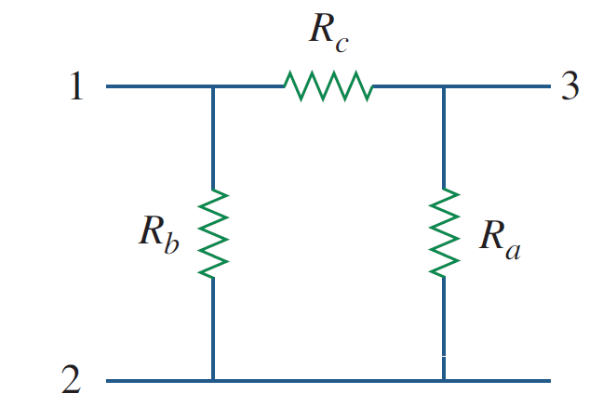
Y- $∆$ AND $∆$ -Y CONVERSIONS
Example Transform the wye network in Figure shown to a delta network.

Slide 50
Y- $∆$ AND $∆$ -Y CONVERSIONS
Example Transform the wye network in Figure shown to a delta network.
Solution:-
$$R_{a}=\frac{R_{1}R_{2}+R_{2}R_{3}+R_{3}R_{1}}{R_{1}}$$
$$R_{b}=\frac{R_{1}R_{2}+R_{2}R_{3}+R_{3}R_{1}}{R_{2}}$$
$$R_{c}=\frac{R_{1}R_{2}+R_{2}R_{3}+R_{3}R_{1}}{R_{3}}$$

Slide 51
Y- $∆$ AND $∆$ -Y CONVERSIONS
Example Transform the wye network in Figure shown to a delta network.
Solution:-
$$R_{a}=\frac{R_{1}R_{2}+R_{2}R_{3}+R_{3}R_{1}}{R_{1}}$$
$$= \frac{\left(10\right)\left(20\right)+\left(20\right)\left(40\right)+(40)(10)}{10}=\frac{1400}{10}=140 Ω$$
$$R_{b}=\frac{R_{1}R_{2}+R_{2}R_{3}+R_{3}R_{1}}{R_{2}}$$
$$R_{c}=\frac{R_{1}R_{2}+R_{2}R_{3}+R_{3}R_{1}}{R_{3}}$$
140 Ω

Slide 52
Y- $∆$ AND $∆$ -Y CONVERSIONS
Example Transform the wye network in Figure shown to a delta network.
Solution:-
$$R_{a}=\frac{R_{1}R_{2}+R_{2}R_{3}+R_{3}R_{1}}{R_{1}}$$
$$= \frac{\left(10\right)\left(20\right)+\left(20\right)\left(40\right)+(40)(10)}{10}=\frac{1400}{10}=140 Ω$$
$$R_{b}=\frac{R_{1}R_{2}+R_{2}R_{3}+R_{3}R_{1}}{R_{2}}=\frac{1400}{20}=70 Ω$$
$$R_{c}=\frac{R_{1}R_{2}+R_{2}R_{3}+R_{3}R_{1}}{R_{3}}$$
140 Ω
70 Ω

Slide 53
Y- $∆$ AND $∆$ -Y CONVERSIONS
Example Transform the wye network in Figure shown to a delta network.
Solution:-
$$R_{a}=\frac{R_{1}R_{2}+R_{2}R_{3}+R_{3}R_{1}}{R_{1}}$$
$$= \frac{\left(10\right)\left(20\right)+\left(20\right)\left(40\right)+(40)(10)}{10}=\frac{1400}{10}=140 Ω$$
$$R_{b}=\frac{R_{1}R_{2}+R_{2}R_{3}+R_{3}R_{1}}{R_{2}}=\frac{1400}{20}=70 Ω$$
35 Ω
$$R_{c}=\frac{R_{1}R_{2}+R_{2}R_{3}+R_{3}R_{1}}{R_{3}}=\frac{1400}{40}=35 Ω$$
140 Ω
70 Ω

Slide 54
References
Boylestad, Robert L. Introductory circuit analysis. Pearson Education, 2010.
Robbins, Allan H., and Wilhelm C. Miller. Circuit analysis: Theory and practice. Cengage Learning, 2012.
Sadiku, Matthew NO, and Chales K. Alexander. Fundamentals of electric circuits. McGraw-Hill Higher Education, 2007.

